Slide 1
An Introduction to
REST API

Slide 2

What is it ?
JSON
GET
RESPONSE
POST
WEB
RESPONSE
URL
HEADER
INTERNET
API
METHOD
REQUEST
HTTP

Slide 3
What is it ?
REST means
REpresentational
State
Transfer

Slide 4
REpresentational ? State ? Transfer ?
REST is an architectural style which is based on web-standards and the HTTP protocol.
In a REST based architecture everything is a Resource.
A resource is accessed via a common interface based on the HTTP standard methods.
You typically have a REST server which provides access to the resources and a REST client which accesses and modifies the REST resources.

Slide 5
REpresentational ? State ? Transfer ?
Every resource should support the HTTP common operations.
Resources are identified by global IDs (which are typically URIs or URLs).
REST allows that resources have different representations, e.g., text, XML, JSON etc.
Stateless in nature. Excellent for distributed system.
Stateless components can be freely redeployed if something fails, and they can scale to accommodate load changes.
This is because any request can be directed to any instance of a component.

Slide 6
HTTP Methods
The PUT, GET, POST and DELETE methods are typically used in REST based architectures. The following table gives an explanation of these operations:
HTTP Method | CRUD Operation | Description
POST | INSERT | Addes to an existing resource
PUT | UPDATE | Overrides existing resource
GET | SELECT | Fetches a resource. The resource is never changed via a GET request
DELETE | DELETE | Deletes a resource

Slide 7
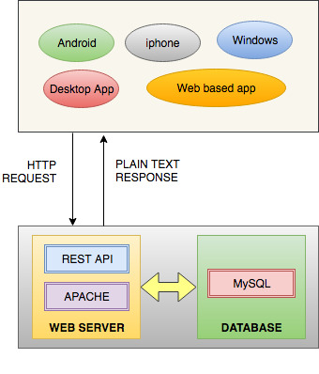
Architecture:

Slide 8
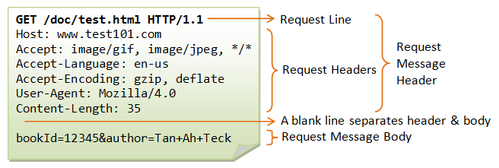
HTTP Request Example:

Slide 9
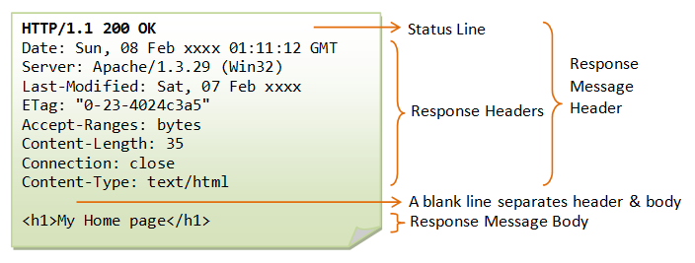
HTTP Response Example:

Slide 10
HTTP REST Request:
HTTP REST API Request
GET https://www.myhost.com/api/v1/user/1/cities
Read, All the cities for user whose id is 1
GET /user/1/cities http/1.1
host: https://www.myhost.com/api/v1
Content-Type: application/json
Accept-Language: us-en
state_id: 2

Slide 11
HTTP REST Response:
HTTP REST API Response
HTTP/1.1 200 OK (285ms)
Date: Fri, 21 Apr 2017 10:27:20 GMT
Server: Apache/2.4.6 (CentOS) OpenSSL/1.0.1e-fips PHP/7.0.16
X-Powered-By: PHP/7.0.16
Content-Length: 109
Keep-Alive: timeout=5, max=100
Connection: Keep-Alive
Content-Type: application/json; charset=UTF-8
{"status":"success","message":"City List","data":[{"city_name":"Visakhapatnam"},{"city_name":"Vijayawada"}]}

Slide 12
HTTP Response Status Code:
1xx | Inform­ational Codes
2xx | Successful Codes
3xx | Redire­ction Codes
4xx | Client Error Code
5xx | Server Error Codes
List at here: https://en.wikipedia.org/wiki/List_of_HTTP_status_codes

Slide 13
Points to be noted
For REST APIs

Slide 14
Use Nouns but no verbs in path/URI:
Purpose | Method | Incorrect | Correct
Retrieves a list of users | GET | /getAllCars | /users
Create a new user | POST | /createUser | /users
Delete a user | DELETE | /deleteUser | /users/10
Get balance of user | GET | /getUserBalance | /users/11/balance

Slide 15
Use plural nouns:
Do not mix up singular and plural nouns. Keep it simple and use only plural nouns for all resources.
/cars instead of /car /users instead of /user /products instead of /product /settings instead of /setting

Slide 16
GET method should not alter the state:
Use PUT, POST and DELETE methods instead of the GET method to alter the state.
Do not use GET method or Query parameters for state changes:
GET /users/711?activate or
GET /users/711/activate

Slide 17
Use sub-resources for relation:
If a resource is related to another resource use subresources
GET /cars/711/drivers/ (Returns a list of drivers for car 711)
GET /cars/711/drivers/4 (Returns driver #4 for car 711)

Slide 18
Use HTTP headers for serialization formats:
Both, client and server need to know which format is used for the communication. The format has to be specified in the HTTP-Header.
Content-Type defines the request format.
Accept defines a list of acceptable response formats.

Slide 19
Versioning is important:
Make the API Version mandatory and do not release an unversioned API.
Use a simple ordinal number and avoid dot notation such as 2.5
We are using the url for the API versioning starting with the letter “v”
/blog/api/v1

Slide 20
Handle Errors with HTTP Status code:
200 | OK (Everything is working) | 403 | Forbidden (The server understood the request, but is refusing it or the access is not allowed)
201 | OK (New resource has been created) | 404 | Not found (There is no resource behind the URI)
204 | OK (Resource successfully deleted) | 405 | Method not allowed
400 | Bad Request (The request was invalid or cannot be served. The exact error should be explained in the error payload. E.g. „The JSON is not valid“) | 408 | Request timeout
401 | Unauthorized (The request requires an user authentication) | 500 | Internal server error

Slide 21
Filtering:
Use a unique query parameter for all fields or a query language for filtering.
GET /cars?color=red (Returns a list of red cars)
GET /users?name=tom (Returns a list of users whose name matches tom)

Slide 22
Sorting:
Allow ascending and descending sorting over multiple fields.
GET /cars?sort=-manufacturer,+model
This returns a list of cars sorted by descending manufacturers and ascending models)

Slide 23
Paging:
Use limit and offset. It is flexible for the user and common in leading databases.
The default should be limit=20 and offset=0
GET /cars?offset=10&limit=5

Slide 24
Aliases for common queries:
To make the API experience more pleasant for the average consumer, consider packaging up sets of conditions into easily accessible RESTful paths.
For example consider following use case:
POST /users (User Register: Creates a new user)
POST /users/login (User Login: Creates auth token for user authentication)

Slide 25
END
Any Question?

